Slide 1
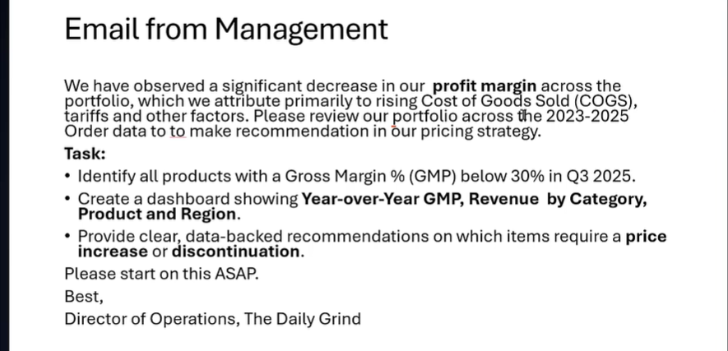
Management Request
The project was initiated by a clear operational pricing brief.
What management asked for
Identify every product with Gross Margin below 30% in Q3 2025.
Show year-over-year margin and revenue by category, product and region.
Recommend which items need a price increase or discontinuation.
Primary business problem
Rising COGS is eroding portfolio profitability and requires a pricing response.

Slide 2
End-to-End Project Workflow
A single analytical chain from raw order data to management action.
01
02
03
04
05
✉
DB
SQL
BI
✓
Business Brief
SQL Database
Data Preparation
Power BI Analysis
Recommendations
Translate the email into measurable analysis questions.
Create grid_sales and import orders, customers and products.
Union three years, join dimensions and clean missing revenue.
Build dynamic KPIs, filters, trends and product breakdowns.
Flag low-margin products and propose pricing actions.
Deliverable: a decision-ready pricing dashboard supported by traceable SQL logic.

Slide 3
SQL Data Preparation
The analytical dataset was assembled directly in SQL Server before loading into Power BI.
;WITH all_orders AS (
SELECT ... FROM Orders_2023
UNION ALL
SELECT ... FROM Orders_2024
UNION ALL
SELECT ... FROM Orders_2025
)
SELECT
a.OrderID, a.CustomerID, c.Region,
a.ProductID, a.OrderDate,
DATEADD(WEEK,DATEDIFF(WEEK,0,a.OrderDate),0) AS week_date,
c.CustomerJoinDate, a.Quantity, a.Revenue,
CASE WHEN a.Revenue IS NULL
THEN p.Price * a.Quantity
ELSE a.Revenue END AS CleanRevenue,
a.Revenue - a.COGS AS Profit,
a.COGS, p.ProductName, p.ProductCategory,
p.Price, p.Base_Cost
FROM all_orders a
LEFT JOIN Customers c ON a.CustomerID = c.CustomerID
LEFT JOIN Products p ON a.ProductID = p.ProductID
WHERE a.CustomerID IS NOT NULL;
UNION ALL
Combines 2023, 2024 and 2025 orders into one fact dataset.
LEFT JOIN
Adds region, customer join date and product attributes.
CLEAN REVENUE
Replaces missing revenue with Price × Quantity.
WEEK START
Creates a weekly date field for trend analysis in Power BI.
Output: one analysis-ready dataset connected through Get Data → SQL Server → Advanced SQL statement.

Slide 4
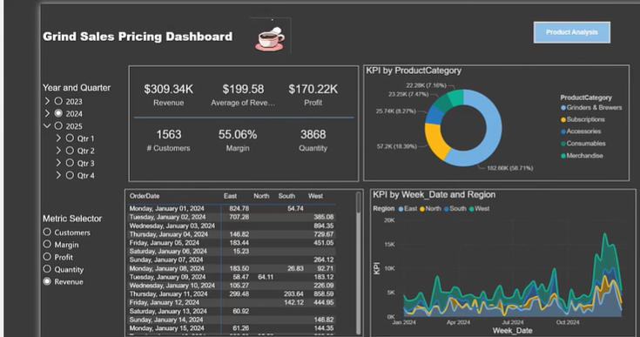
Power BI Dashboard Overview
A compact executive view with year, quarter and metric switching.
01
Year & Quarter
Filters the portfolio across 2023–2025 and Q1–Q4.
02
Dynamic KPI Selector
Switches Customers, Margin, Profit, Quantity and Revenue.
03
Weekly Regional Trend
Shows how the selected KPI changes over time by region.
The dashboard is designed for fast management scanning: one page, limited visuals and direct access to product analysis.

Slide 5
Key Findings
The portfolio remains profitable, but margin quality weakened across the three-year period.
Gross Margin — 2023
Gross Margin — 2024
Gross Margin — 2025
3-Year Change
56.64%
55.06%
52.43%
−4.21 pp
Starting point
−1.58 percentage points
−2.63 percentage points
2023 → 2025
Low-margin products requiring action
What the numbers mean
Product
Margin
Priority
The margin decline is persistent, not a one-off fluctuation.
The three severely low-margin products need immediate pricing or portfolio review.
The Gooseneck Kettle is closer to the threshold and needs a smaller targeted intervention.
A discontinuation decision should also consider demand and revenue, not margin alone.
Chemex Filters (100 pack)
14.58%
Critical
Minimalist Keychain
15.59%
Critical
Logo Hoodie (Black)
16.34%
Critical

Slide 6
Pricing Recommendations
Actions are prioritized by margin severity and commercial value.
Chemex Filters (100 pack)
Immediate review
Decision Rule
Increase price by approximately 20–22% if COGS stays unchanged; discontinue only if demand is weak.
Low margin + High demand
Raise price first
Minimalist Keychain
Immediate review
Apply a similar price increase or remove from the portfolio if it has low sales volume and limited strategic value.
Low margin + Low demand
Consider discontinuation
Logo Hoodie (Black)
Immediate review
Near 30% threshold
Raise price and validate customer acceptance; discontinue only if both margin and demand remain weak.
Use a targeted adjustment
High margin + Low demand
Gooseneck Electric Kettle
Targeted adjustment
Treat as a growth opportunity
Use a smaller price increase or cost reduction to restore Gross Margin above the 30% threshold.
Assumption: COGS remains constant during the initial pricing simulation.

Slide 7
Recommended Management Action Plan
Turn the dashboard findings into controlled commercial action.
1
Validate
2
Simulate
3
Approve
4
Monitor
Confirm the Q3 2025 filter, product margins and missing-value assumptions.
Model 20–22% price uplifts for critical items and smaller adjustments for near-threshold products.
Review elasticity, competitive pricing and product demand with operations and commercial owners.
Track revenue, units, gross profit and margin after implementation.
Week 1
Week 1–2
Week 2–3
Monthly
Success metrics: Gross Margin above 30% for flagged products, no material demand collapse, and a measurable improvement in gross profit contribution.

Slide 8
Appendix | Core SQL Query
The exact query used to combine the order years and prepare the Power BI dataset.
-- combining the order years
;WITH all_orders AS (
SELECT OrderID, CustomerID, ProductID, OrderDate, Quantity, Revenue, COGS FROM Orders_2023
UNION ALL
SELECT OrderID, CustomerID, ProductID, OrderDate, Quantity, Revenue, COGS FROM Orders_2024
UNION ALL
SELECT OrderID, CustomerID, ProductID, OrderDate, Quantity, Revenue, COGS FROM Orders_2025
)
-- building the main dataset query
SELECT
a.OrderID,
a.CustomerID,
c.Region,
a.ProductID,
a.OrderDate,
DATEADD(WEEK, DATEDIFF(WEEK, 0, a.OrderDate), 0) AS week_date,
c.CustomerJoinDate,
a.Quantity,
a.Revenue,
CASE WHEN a.Revenue IS NULL THEN p.Price * a.Quantity ELSE a.Revenue END AS cleandrevenue,
a.Revenue - a.COGS AS profit,
a.COGS,
p.ProductName,
p.ProductCategory,
p.Price,
p.Base_Cost
FROM all_orders AS a
LEFT JOIN customers AS c ON a.CustomerID = c.CustomerID
LEFT JOIN products AS p ON a.ProductID = p.ProductID
WHERE a.CustomerID IS NOT NULL; -- dropping null CustomerID rows

Slide 9
Appendix | Dynamic KPI Logic
The slicer-driven measure allows the same visuals to switch between key business metrics.
KPI =
SWITCH(
TRUE(),
SELECTEDVALUE('Metric Selector'[Metric Selection]) = "Revenue",
SUM(Query[Revenue]),
SELECTEDVALUE('Metric Selector'[Metric Selection]) = "Quantity",
COUNT(Query[OrderID]),
SELECTEDVALUE('Metric Selector'[Metric Selection]) = "Profit",
SUM(Query[profit]),
SELECTEDVALUE('Metric Selector'[Metric Selection]) = "Margin",
(SUM(Query[Revenue]) - SUM(Query[COGS])) / SUM(Query[Revenue]),
"no value"
)
Why it matters
One visual can display Revenue, Profit, Margin, Quantity or Customers.
The dashboard stays compact and avoids duplicating charts.
Management can explore different performance views without leaving the page.
Result: cleaner user experience and faster decision-making.

